Slide 1


Quebec City Cultural Trip
Wednesday June 10th – Saturday, June 13th 2020
Parent Information Meeting
21 November, 2019

Slide 2
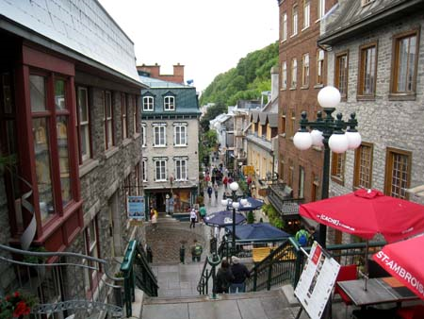

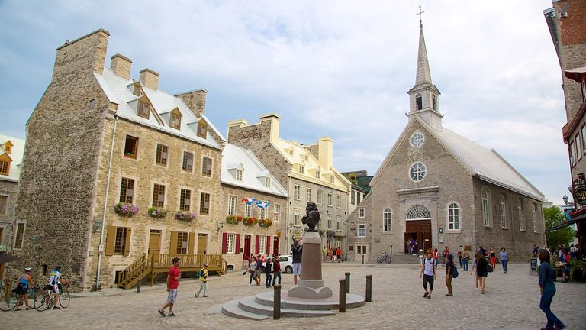
Key Activities
Pre-European Period (pre-1608)
French Period (1608 – 1763)
British Period (1763 – 1867)
  Guided Walking Tour of Old Quebec Lower Town – Le Cartier Petit Champlain
  Place Royal – birthplace of New France
  Upper Town – Chateau Frontenac

Slide 3
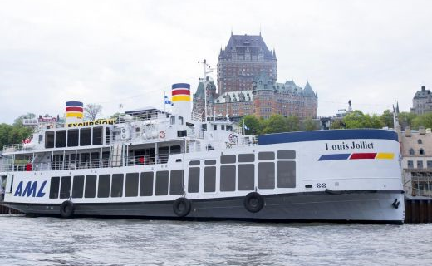
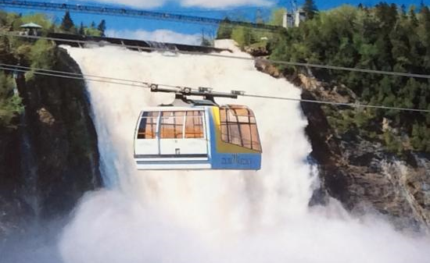

Key Activities (continued)
Québec and Region
  Legislature Building & Grounds
  River Dance Cruise
  Aquarium
  Canyon Sainte-Anne
  Ste Anne’s Basilica
French Practice
  Free Time in Old Quebec and
  Galleries de la Capitale
  Guided Tours
  Improvisation Activity

Slide 4

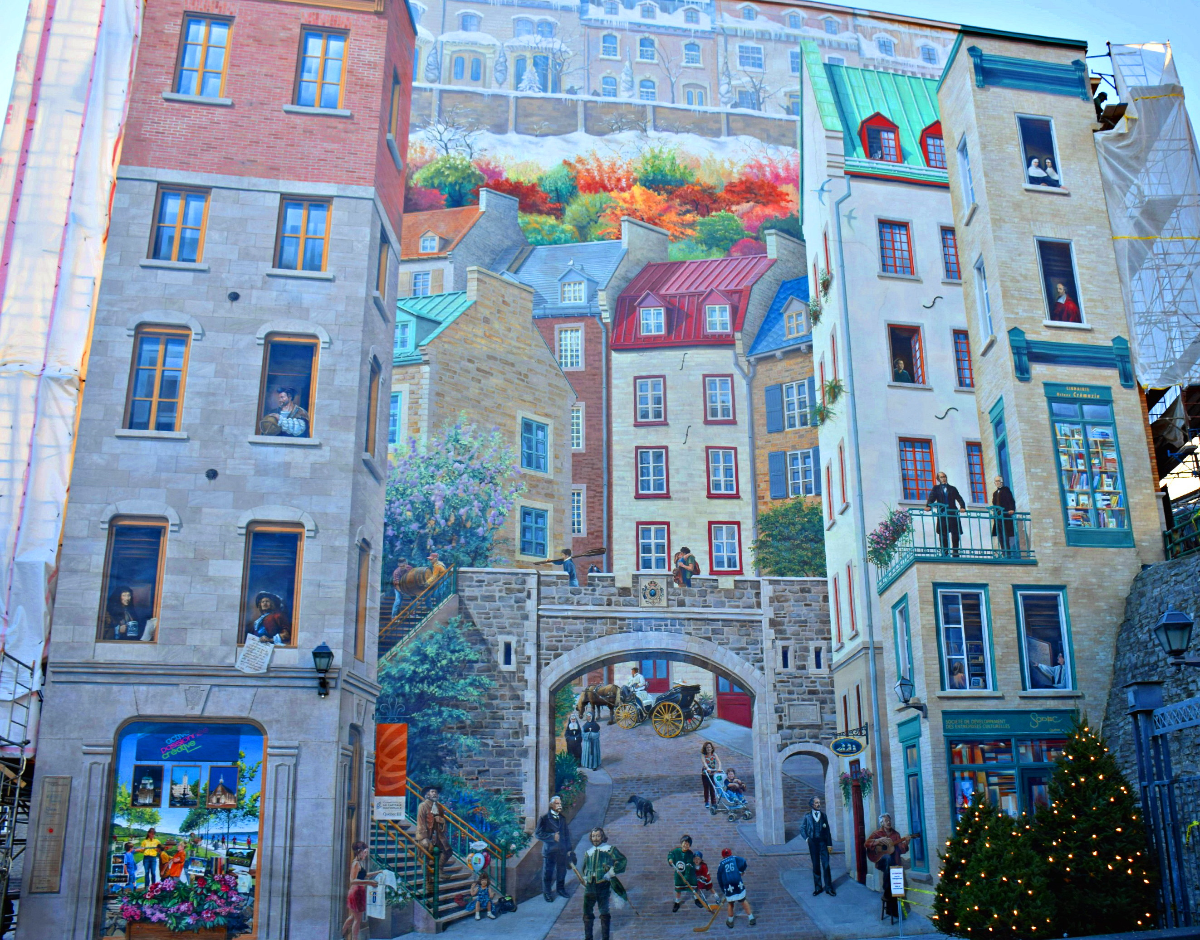

Key Activities (continued)
Sports and Arts
  Lots of walking & dancing
  BORA indoor water park
  Murals and architecture

Slide 5
Itinerary
Wed PM | Wed Evening | Thurs AM | Thurs PM | Thurs Evening | Fri Am | Fri PM | Fri Evening | Sat AM
Aquarium | Cabane à Sucre Walking tour in Lower Town | Legislature and Old Quebec- Walking tour and free time Switch AM/PM | Museum Activities Italian buffet at BORA | BORA Indoor Water Park | Ste. Anne Basilica and Canyon Sainte-Anne | Galleries de la Capitale (shopping and indoor amusement park) | Buffet des Continents. Dance Cruise | Improv Let’s go home!!!

Slide 6
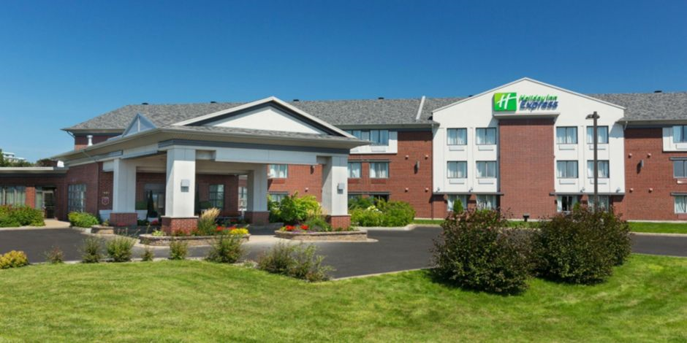
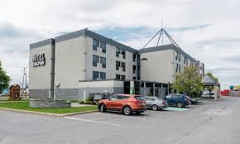
Accommodations
3-4 star Hotel
  2 queen beds in each room
  Hot & Cold Buffet Breakfast
  10-20 minute drive to all activities
  Night security in the halls from
  10:30 pm – 4:00 am
  4 students per room
  2 chaperones per room

Slide 7
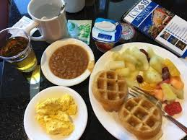
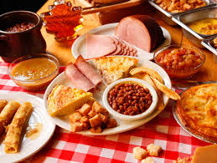
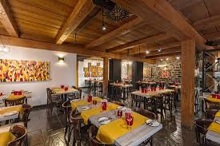
Meals
Included
Breakfast at Hotel (3)
All-you-can-eat buffet suppers (3)
  Érablière du Lac Beauport (Sugar Shack)
  Spag & Tini’s (Italien)
  Buffet des Continents
Excluded
4 x Lunch / 1 x Supper (plan for $10-12 each)

Slide 8

Show your Cougar PRIDE
 | Class | Common Areas | Community
P Prepared | I am prepared when I … - have my supplies (books, pen/pencil, etc.). - arrive on time. - attend all classes. | I am prepared when I … - have my supplies (lunch, money, clothing, etc.). - have a plan/destination. - arrive on time. | I am prepared when I … - have my supplies (equipment, clothing, etc.). - arrive on time.
R Respect | I show respect when I … - exercise kindness. - follow classroom procedures. - use materials properly. | I show respect when I … - exercise kindness. - leave an area cleaner than the way I found it. - follow procedures (hands to self, feet to self, line up, etc.). | I show respect when I … - exercise kindness. - use positive words and actions. - use appropriate volume/tone/language.
I Involved | I am involved when I … - participate and listen actively. - share ideas. - am a valuable team member. | I am involved when I … - speak up. - support school events. - join in. | I am involved when I … - help others. - am a role model. - volunteer.
D Determined | I show determination when I … - persevere. - seek / accept assistance. - set goals. | I show determination when I … - use time wisely. - interact with purpose. | I show determination when I … - work with others. - make a positive difference.
E Effort | I display effort when I … - give 100% and produce quality work. - accept a challenge. - know attendance matters. | I display effort when I … - own my actions. - encourage others. - problem solve. | I display effort when I … - support community needs. - represent the school with PRIDE at all times.

Slide 9
Eligibility
Maximum of 100 students - 50/bus
First come, first served beginning Nov 21st.
- Form (double sided) holds the spot
- Deposit (paid online by Dec 6th) secures the spot
- Waiting list will be established beyond 100 students
Participation will be revoked if serious infractions or chronic minor infractions are noted during the school year. Spots vacated will be filled with a student on the waiting list.
No refund is guaranteed if a student removes themselves or if they are removed from the trip.

Slide 10
Chaperones
Ratio of 1:10
Local Tour Directors will join the group in Quebec City – available 24/7
  Coordinate the tour
  Animate and explain
  Ensure that the kids have fun and learn
  Main support for the chaperones
  Troubleshoot any problems

Slide 11
Payment Schedule
December 6th – deadline for the ‘non-refundable’ deposit due to the school ($182) paid via SchoolCash ($175 deposit + $7 transaction fee). Deposits will open on Nov 25th. Do not pay the deposit until your child has a confirmed seat.
Following the deposit deadline, an online invoice will be sent by Bon Vivant to parents and will be payable directly directly to them:
  - Balance ($500) due in 2 equal payments:
    End Jan ($250)
    End Mar ($250)

Slide 12
Fundraising / Financial Assistance
The school does not organize fundraising
Option for students to initiate fundraising activities:
  Organized by parent volunteers
  Organized by student(s)
Financial Assistance is available through the school – contact Mr. Nelson

Slide 13
What to bring
One suitcase + one carry-on bag
Students may wish to bring a pillow and blanket for the bus ride
Medication (prescription and non-prescription must be identified prior).
Clothing:
  Comfortable shoes (sneakers) for walking
  Light jacket / hoodie for evenings (rain jacket or umbrella depending on weather)
  One ‘dressy’ outfit for dinner / cruise evening
  Toiletries and sunscreen
  Sunglasses / hat
  Bathing suit and a towel for the water park

Slide 14
How much spending money is needed?
Breakfast and supper (except Saturday supper) are included.
Students are responsible for:
  Four lunches
  One Supper (Saturday on the ride home)
  Idea: Debit Card – set up well in advance of the trip.
  Purchase gift cards (Tim Hortons/McDonalds) before leaving.
  Spending money will depend on your child’s spending habits.

Slide 15
Electronic devices
Students are responsible for any electronic device they bring (phone, camera, tablet, etc.)
Know your phone plan.
Wifi available in rooms.
The buses have Wi-Fi, however, with the number of students on the bus, this can be ‘spotty’.
Cell phone use may be restricted during certain portions of the itinerary (i.e. museum, improve, etc.).
Each student will receive a USB drive containing trip pictures and video.

Slide 16

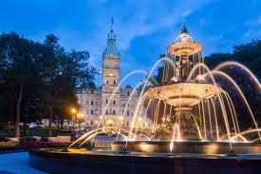
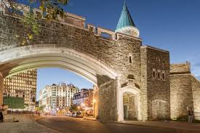

Questions?
Please contact the school at 847-6210 or email jeff.nelson@nbed.nb.ca for more information.

